Slide 1
CSC3007 Information Visualization
Milestone 1
Presented by Group 2:
EDWIN TANG QIN KANG JUNG DUK KYUN JUSTIN LEE ALAN

Slide 2
Topic 1 Proportion of Population That Thinks Religion is Important

Slide 3
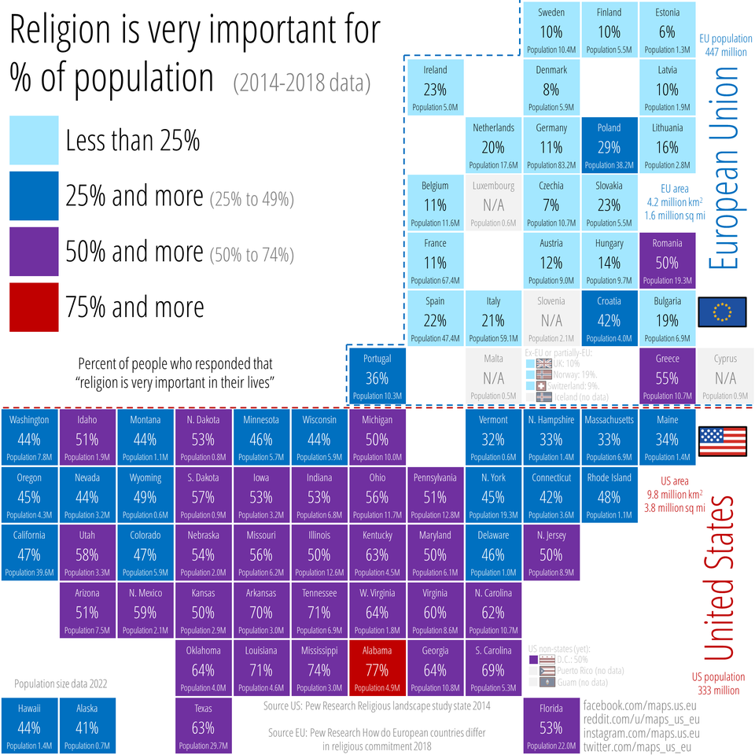
Visualization 1
A heatmap data visualization of the population in US and EU that views religion as important in their lives
Visualization contains legend to shows the color scale based on population percentage
Labels are displayed at the side to show which part of the heatmap belongs to US and EU
Source: https://www.reddit.com/r/Denmark/comments/vfwfoa/danskere_er_iblandt_de_mindst_religi%C3%B8se_mennesker/

Slide 4
What (Data) is shown to user
Good display of percentage of population. However, different colors used for the heatmap make certain text harder to read.
Extra details of information such as:
Name of each state/country in the heatmap.
Number of populations each state/country.
Comparison between United States and European Union is inconsistent due to the data:
Gathered from two different sources: US pew research 2014 and EU pew research 2018.
Shown in different scopes (State-level for US and country-level for EU)
The links beside Florida population is misleading; May be treated as sources for the chart
Source: https://www.reddit.com/r/Denmark/comments/vfwfoa/danskere_er_iblandt_de_mindst_religi%C3%B8se_mennesker/
Notes:
Source comes from US pew research 2014 and EU pew research 2018. Hence the data gathered does not correlate to each other. (wrong data category)

Slide 5
Why (Task) user intent to use
Provide an account of the size of religious groups that populate US and EU
Document the religious profile of the US and EU
Showcase and emphasize the areas that are heavily populated with a religious profile
Source: https://www.reddit.com/r/Denmark/comments/vfwfoa/danskere_er_iblandt_de_mindst_religi%C3%B8se_mennesker/

Slide 6
How (Idiom) is designed
Contains too many variables; Hard for user to comprehend immediately
Population size of 2022 data of hawaii and alaska contradicts with the focus on the importance of population overall focus is on 2014 and 2018
The data from the two different years are placed within the same graphics, this implies a comparison between US and EU data sets. However it is not valid and thus makes the comparison ineffective.
Extraneous data in different places within the same chart clutters the diagram
Source: https://www.reddit.com/r/Denmark/comments/vfwfoa/danskere_er_iblandt_de_mindst_religi%C3%B8se_mennesker/

Slide 7
How (Idiom) is designed (cont.)
The color of the text and the boxes together makes it hard to read the text
The gaps between certain boxes make the diagram disoriented
Hard to justify the reliability of the data for some countries:
For the EU population, some countries like UK, Norway, Switzerland, Iceland have the data of importance of religion
However they do not have data on the population.
Source: https://www.reddit.com/r/Denmark/comments/vfwfoa/danskere_er_iblandt_de_mindst_religi%C3%B8se_mennesker/

Slide 8
Improvements on Visualization 1
The way the diagram is plotted is similar to how both US and EU shown in the geographical map. Hence, they can actually plot a choropleth map instead which is more representative of the data they have to show.
Comparison of data should be based on the same timeline instead of comparing between different years, or respective country comparing their two different timelines.
The population comparison should be either between countries or states.
Text color should contrast with the color of the boxes for better visibility.

Slide 9
Topic 2
Ratio of Unit Types Lost for Russia/Ukraine

Slide 10
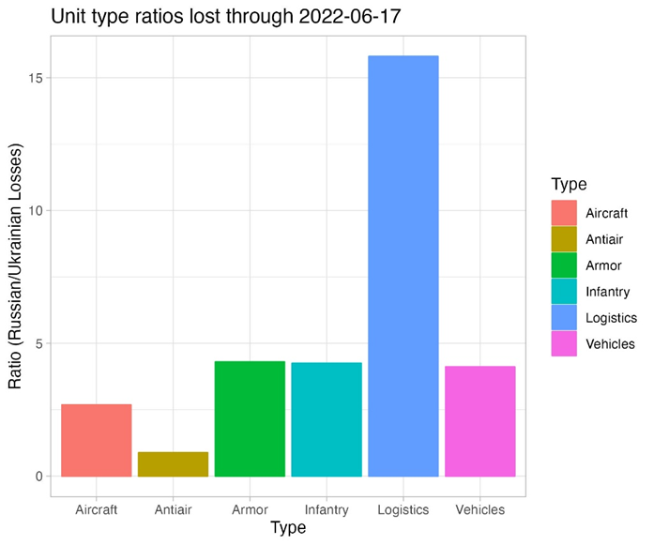
Visualization 2
A static visualization of the Russian / Ukrainian losses of unit type since the Russia invasion of Ukraine on 24 February 2022
Provide an easier view of the highest ratio losses of each unit
E.g. of unit type are Aircraft, Anti-Air, Armor, Infantry, Logistics, Vehicles
Source: https://github.com/leedrake5/Russia-Ukraine

Slide 11
What (Data) is shown to user
Data gathered comes from a public Google Sheet that is updated regularly since 24 February 2022
Ratio of Russian to Ukraine units losses for each type
No absolute value given for the amount of losses on both sides
https://docs.google.com/spreadsheets/d/1bngHbR0YPS7XH1oSA1VxoL4R34z60SJcR3NxguZM9GI/edit#gid=1158043451
Source: https://github.com/leedrake5/Russia-Ukraine

Slide 12
Why (Task) user intent to use
Explanatory visualisation
Understand and compare the proportion of unit losses
A little bit of exploratory to infer a strategy of war from either sides
Source: https://github.com/leedrake5/Russia-Ukraine

Slide 13
How (Idiom) is designed
Ratio plotted on a simple bar chart
Difficulties in interpreting data:
The higher the amount of losses from Russian side, the taller the bar and vice versa
Not intuitive to derive any meaning
Mental model of bar charts do not reflect ratio
Source: https://github.com/leedrake5/Russia-Ukraine

Slide 14
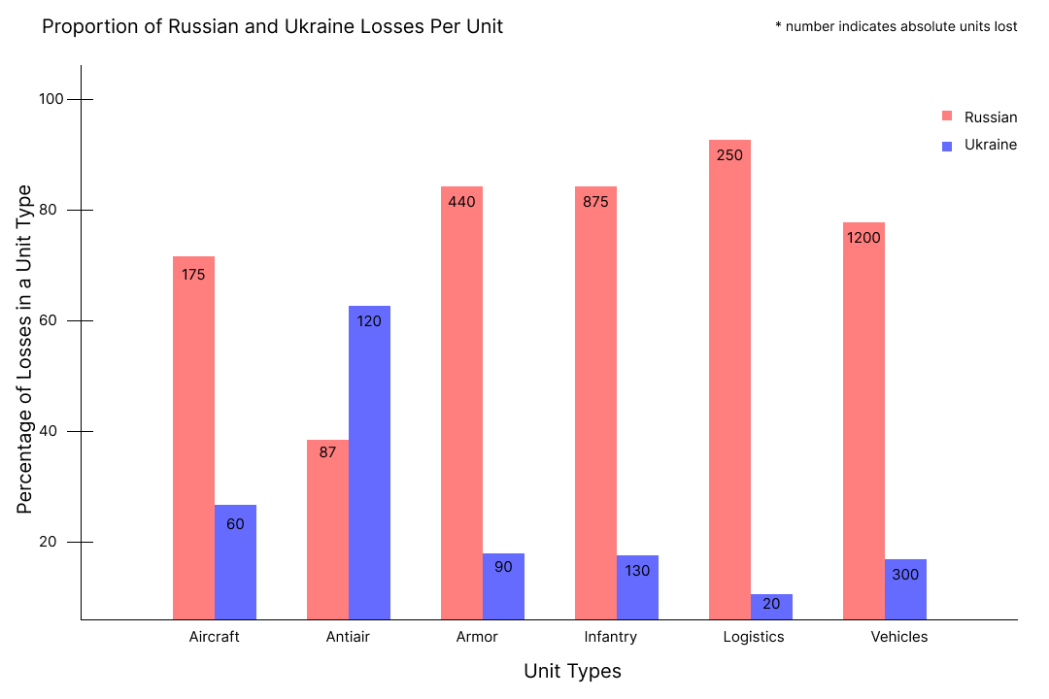
Improvements on Visualization 2
A different idiom to show proportion of losses rather than the ratio itself such as display the percentage losses.
Bar chart can be split into country value to provide users a high level of total losses indicated instead of ratio.

Slide 15
THE END

